Slide 1

Query Optimization
Presented By:
Elizer Ponio Jr. Department of Computer Science
College of Computing and Information Technologies

Slide 2
Outline
What is Query Processing?
Basic Steps in Query Processing
Parsing and Translation
Evaluation
Optimization

Slide 3
Introduction
User queries have to be executed on the database contents, which reside on storage devices.
It is usually convenient to break up queries into smaller operations, roughly corresponding to the relational-algebra operations

Slide 4
What is Query Processing?
Query processing is the process of translating a high-level query, such as SQL, into a low-level query that can be executed by the database system.
The steps involved in processing a query are parsing and translation, optimization and evaluation
Parsing and Translation
Optimization
Evaluation

Slide 5
Basic Steps in Query Processing
Parsing and Translation
The first step in query processing.
Optimization
The cost of the query evaluation can vary for different types of queries.
Evaluation
Generate query execution plan
When a user executes any query, the queries undergo lexical, syntactic, and semantic analysis.
The query-execution engine takes a query-evaluation plan, executes that plan, and returns the answers to the query
Once analysis is completed, it converts all the tokens into relational expressions, graphs, and trees.
Query Optimization is when a database system generates an efficient query evaluation plan, which minimizes its cost
To optimize a query, the query optimizer estimates the cost analysis of each operation.
The overall operation cost depends on the memory allocations to several operations, execution costs, and so on.

Slide 6
Query Processing Steps

Slide 7

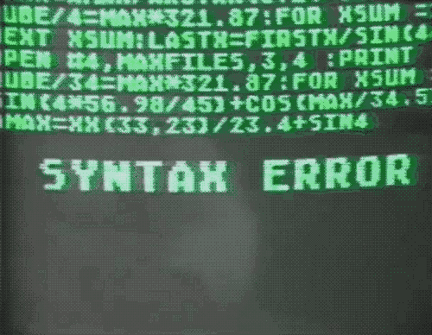

Parsing and Translation
The parsing stage involves separating the pieces of a SQL statement into a data structure that other routines can process
When a user executes a query, it performs checks that identify errors in the statement. These checks include lexical, syntactic, and semantic analysis.
Lexical Analysis
Syntactic Analysis
Semantic Analysis

Slide 8
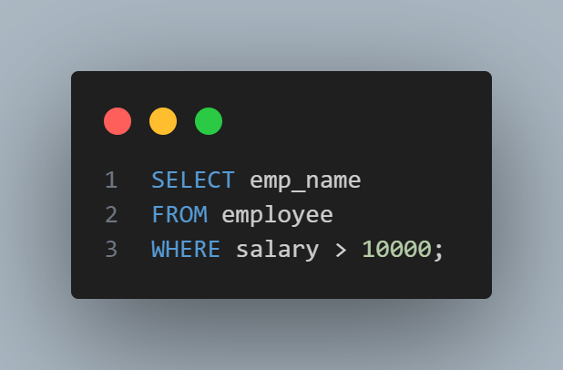
Parsing and Translation (continued)
In Lexical Analysis, the query gets broken down into different tokens and white spaces are removed along with the comments .
The above query would be broken down into the following tokens:
SELECT
emp_name
FROM
employee
WHERE
salary
>
10000

Slide 9

Parsing and Translation (continued)
In Syntactic Analysis, the query gets checked for the correctness, both syntax and semantic wise.
The query processor first checks the query if the rules of SQL have been correctly followed or not.
Is there a table name given after the word FROM?
Is there a column name given after the word SELECT?

Slide 10
Parsing and Translation (continued)
In Semantic Analysis, the query processor checks if the meaning of the query is right or not.
Check if the employee table in the query actually exist in the database
Check if the emp_name column in the query actually exist database

Slide 11
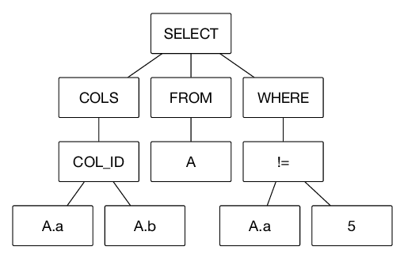
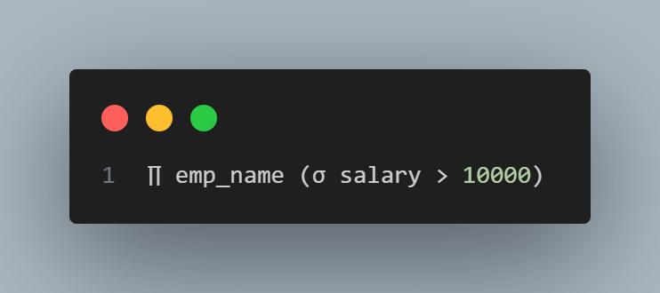
Parsing and Translation (continued)
The next step is to convert all the tokens into relational expressions or graphs, or trees
These are easy to handle for the optimizer in further processes.
Relational Algebra
Trees

Slide 12
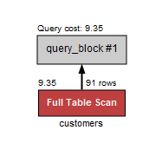
Evaluation
Execution Plan in is a representation of different operations performed by the SQL query processor. When you execute any query then the query processor will generate an execution plan along with the Query to be initiated.
Identifying query workflow, operators, and components begins with query execution plan

Slide 13
Evaluation
In query evaluation, a query execution plan is generated that is used to evaluate a query.
A query execution plan consists of a sequence of operations which are annotated with instructions to.
Operations are annotated in-order to evaluate each of them.
Different execution plans for a given query can have different costs.

Slide 14
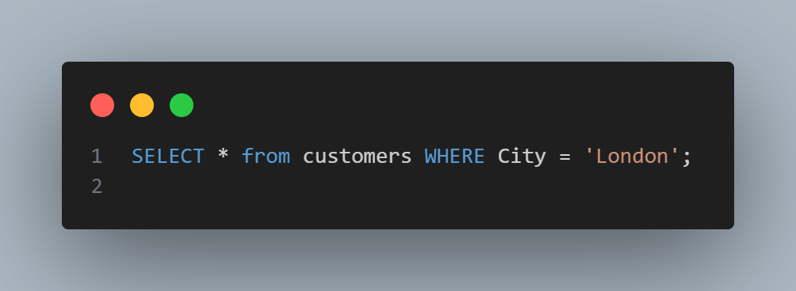
In mySQL Workbench, execution plans are represented as graphical diagrams.

Slide 15
Optimization
In query optimization, it chooses the most efficient execution plan based on the cost each plan has. The aim here is to minimize the query evaluation time.
It also finds out the best order of subqueries to be executed so as to ensure only the best of the plans gets executed.
Simply put, for any query, there are multiple evaluation plans to execute it.

Slide 16




Optimization
Some of the factors weighed in by the optimizer to calculate the cost of a query evaluation plan are
CPU time
Number of tuples to be scanned
Disk access time
Number of Operations

